Slide 1

Resilience Engineering

Slide 2
Training Objectives
to get insight into the theory of resilience engineering
to obtain practical advice on how to implement the principles of resilience engineering.

Slide 3
3
Questions

Slide 4
Three Questions
What is Resilience?
What is Resilience Engineering?
Why does it become more and more difficult to grade the results of Safety Programs?

Slide 5
Three Questions
What is Resilience?
What is Resilience Engineering?
Why does it become more and more difficult to grade the results of Safety Programs?

Slide 6

Video Link: http://www.youtube.com/watch?v=rR2EFH4aJcs
Click

Slide 7
Three Questions
What is Resilience?
What is Resilience Engineering?
Why does it become more and more difficult to grade the results of Safety Programs?

Slide 8
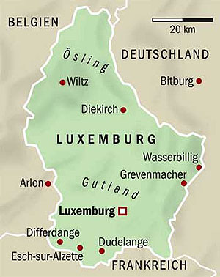



A System

Slide 9
Resilience
Definition:
Ability of a system to adjust its functioning prior to, during, or following changes and disturbances, so that it can sustain required operations under both expected and unexpected conditions.

Slide 10
Resilience
Definition:
Ability
to adjust
prior to
Ability of a system to adjust its functioning prior to, during, or following changes and disturbances, so that it can sustain required operations under both expected and unexpected conditions.
during
following
disturbances
expected
unexpected
Aim: maintain required operation.

Slide 11

Example 1
Resilient to foreseen disturbance

Slide 12
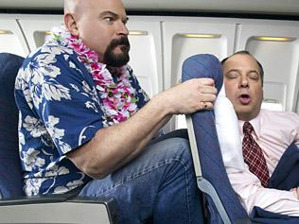
Example 2
Resilient to unforeseen disturbance

Slide 13

Example 3
Losing resilience

Slide 14
Resilience Engineering
Error
Management
Resilience
Engineering

Slide 15
Three Questions
What is Resilience?
What is Resilience Engineering?
Why does it become more and more difficult to grade the results of Safety Programs?

Slide 16
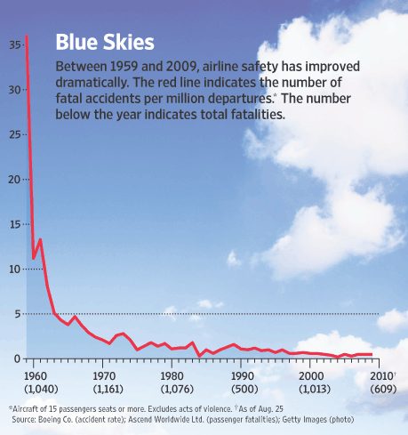
Things that go wrong

Slide 17
100
Things that go wrong
95
90
Things that go right
85
80
75
70
Z

Slide 18
100
95
90
85
Old Safety Programs try to decrease the things that go wrong
80
Resilience Engineering tries to increase the things that go right.
75
70
Z

Slide 19
Video Link: http://www.youtube.com/watch?v=mVt9nIf9VJw
Click

Slide 20
Two views on human error
The Old View of human error on how to make it right
Complex systems are basically safe
Unreliable, erratic humans undermine defenses, rules and regulations
The New View of human error on how to make it right
Complex systems are not basically safe
Complex systems are trade-offs between multiple conflicting goals (e.g. safety and efficiency)

Slide 21
Resilience
Definition:
Ability of a system to adjust its functioning prior to, during, or following changes and disturbances, so that it can sustain required operations under both expected and unexpected conditions.

Slide 22
Resilience
Definition:
Ability of a system to adjust its functioning prior to, during, or following changes and disturbances, so that it can sustain required operations under both expected and unexpected conditions.

Slide 23
Resilience
Definition:
Ability of a system to adjust its functioning prior to, during, or following changes and disturbances, so that it can sustain required operations under both expected and unexpected conditions.
changes and disturbances
System is fluctuating
Risk Profile is changing.

Slide 24
Risk Profile
Every task of a system has a specific Risk Profile

Slide 25
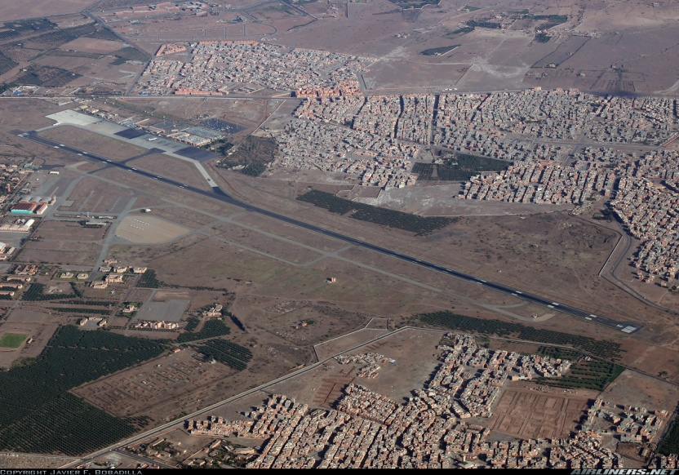
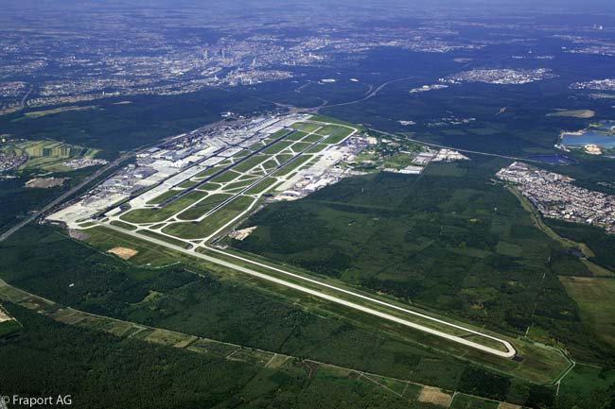
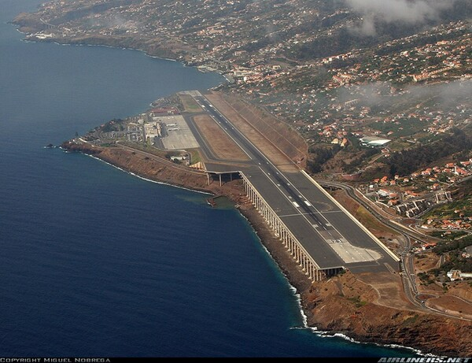
Risk Profile

Slide 26


Risk Profile

Slide 27
Risk Profile
Risk Profile Change
In foreseen or unforeseen situations
Due to internal or environmental conditions.

Slide 28

Risk Profile

Slide 29
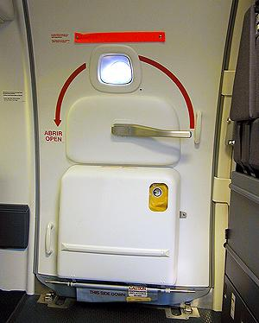
Risk Profile

Slide 30

Risk Profile

Slide 31
Risk Profile
Change of Standard Setting
=
Change of Risk Profile
SCCM – CCM2
SCCM – SCCM
Captain - Copilot
Captain - Captain

Slide 32
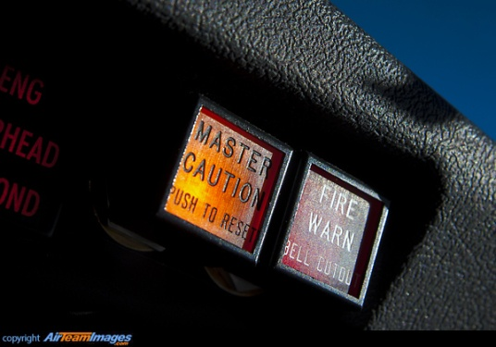





Noticing triggers Action

Slide 33
Noticing triggers Action
When the risk profile changes, coordination between team members seems to be of utmost importance.
Learn the ability to more consistently notice risk profile changes and communicate them.

Slide 34

Risk Profile Change
Exercise
Is the Risk Profile changing?

Slide 35

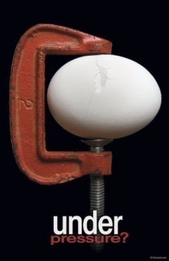
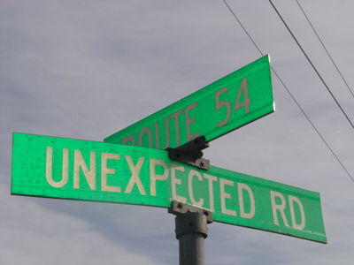
System Variability in Performance
Safety
Limit
Quality
Margin
Target Area
Range
Of
Control
Quality
Margin
Safety
Limit
Under
pressure

Slide 36
System Failures: Loosing Resilience
Decompensation
3
Working at cross-purposes
Getting stuck in outdated behaviours

Slide 37
System Failures: Loosing Resilience
Decompensation
3
Working at cross-purposes
Getting stuck in outdated behaviours

Slide 38

Decompensation

Slide 39


Decompensation

Slide 40


Decompensation
Autopilot

Slide 41

Decompensation
Autopilot

Slide 42

Decompensation
ATC
Captain
Purser
PA
Descent
Performance data

Slide 43

Decompensation
Captain

Slide 44
Decompensation
Captain

Slide 45

Decompensation - Compensation

Slide 46
Decompensation
Team Success

Slide 47

Decompensation

Slide 48
Decompensation
Premonitions
1.
One part of the control system is working harder and harder.

Slide 49

Decompensation
Remedy
Change the operating level by injecting more resources into the control sequence.

Slide 51
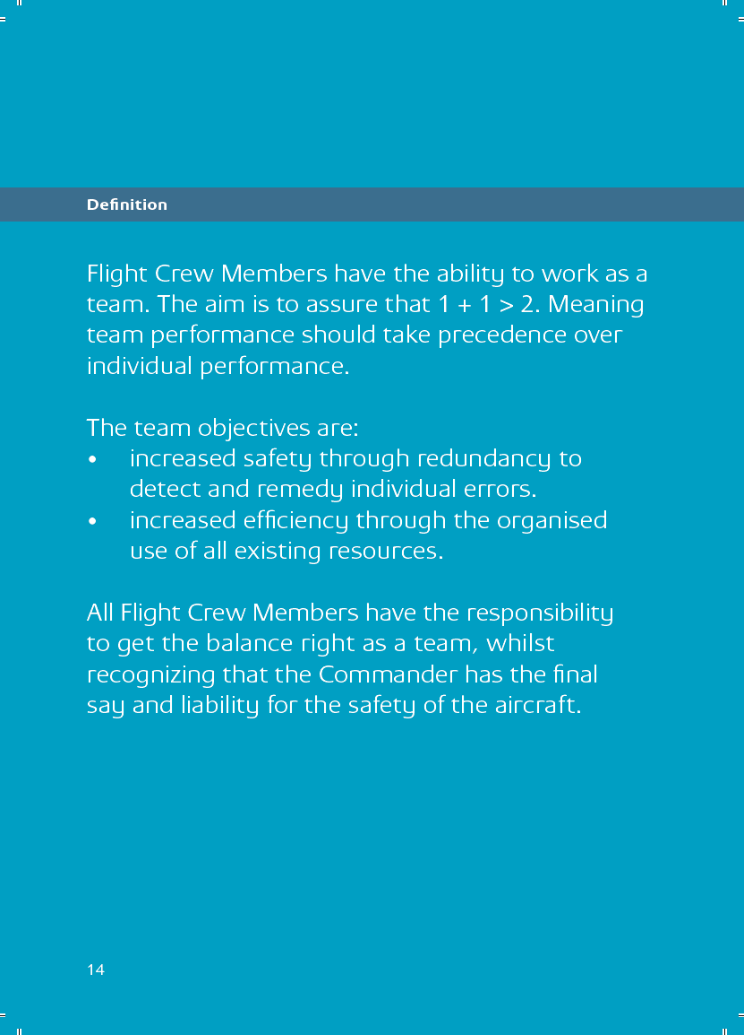
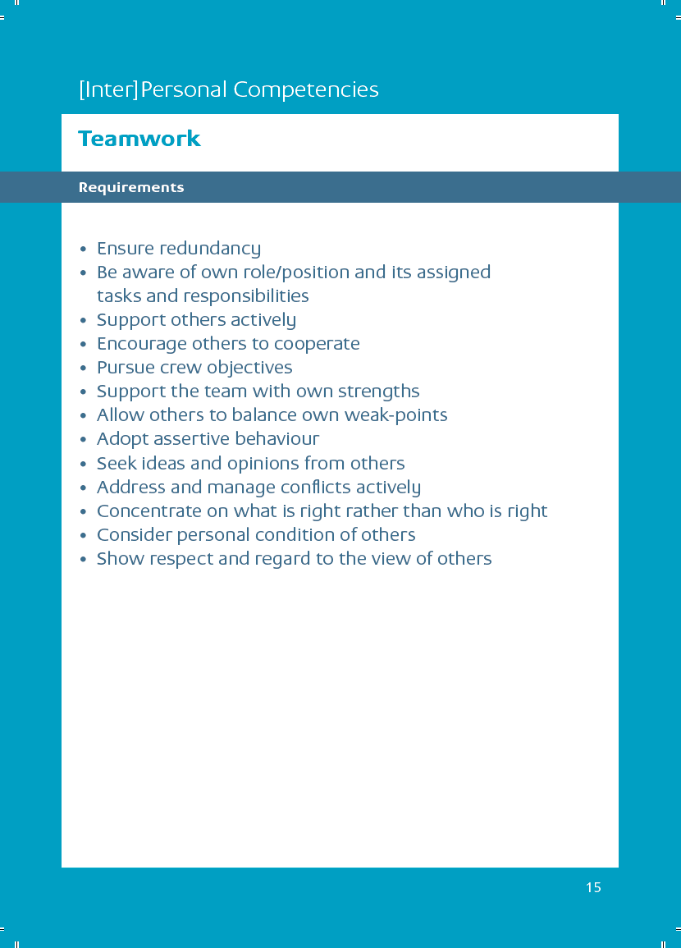
Communication & team behaviour
51

Slide 52
System Failures: Loosing Resilience
Decompensation
3
Working at cross-purposes
Getting stuck in outdated behaviours

Slide 53

Working at cross-purposes

Slide 54

Working at cross-purposes

Slide 55

Working at cross-purposes
Airport Slot

Slide 56
Working at cross-purposes
System Success

Slide 57
Working at cross-purposes

Slide 58
Working at cross-purposes
Premonitions
1.
Top to bottom communication is lost.

Slide 59
Working at cross-purposes
Remedy
Effective communication at a system level, but also at a team or crew level.

Slide 61
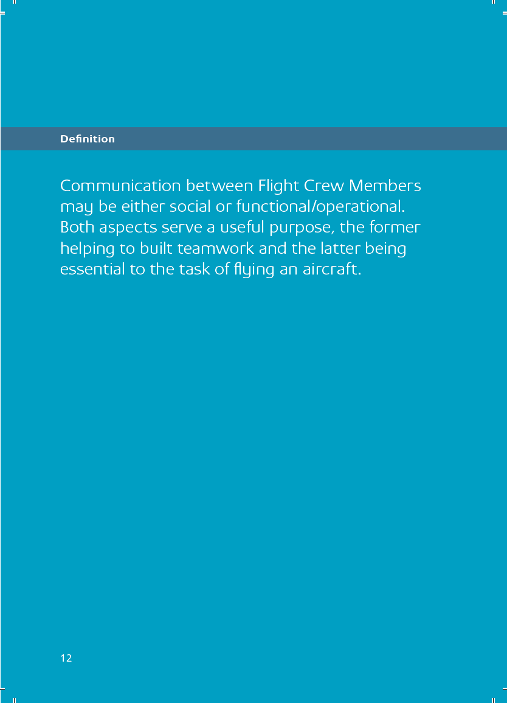
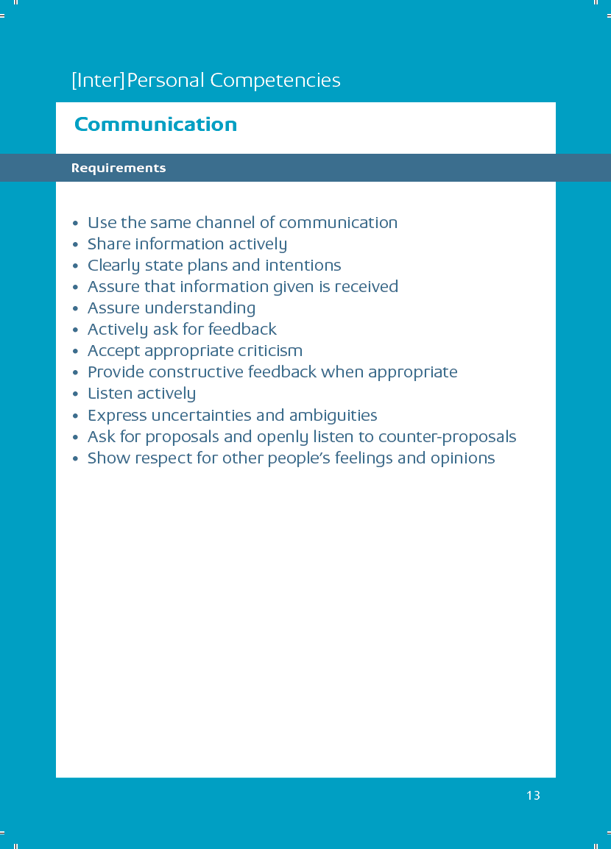
Communication & team behaviour
61

Slide 62
System Failures: Loosing Resilience
Decompensation
3
Working at cross-purposes
Getting stuck in outdated behaviours

Slide 63

Getting stuck in outdated behaviours

Slide 64
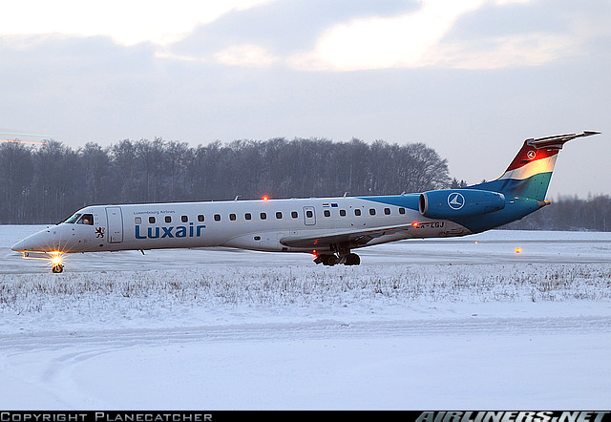
Getting stuck in outdated behaviours

Slide 65
Getting stuck in outdated behaviours

Slide 66
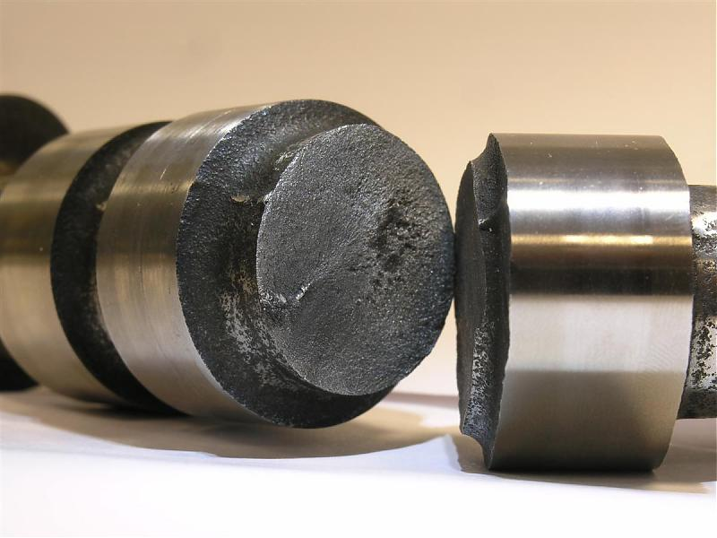
Getting stuck in outdated behaviours

Slide 67
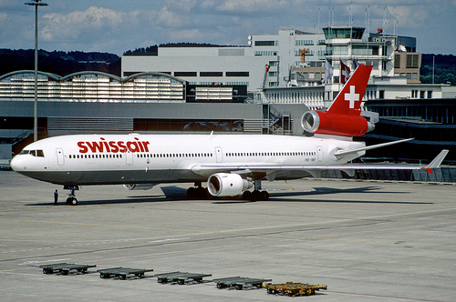
Getting stuck in outdated behaviours
Swissair 111

Slide 68
Getting stuck in outdated behaviours
Task Success

Slide 69
Getting stuck in outdated behaviours

Slide 70
Getting stuck in outdated behaviours
Premonitions
1.
A lot of small things go wrong, minor incidents happen
2.
No common team understanding of the situation.

Slide 71
Getting stuck in outdated behaviours
Remedy
Pursue all signs, especially those which do not confirm your view of the world. Consult your team in order to have a common understanding of the situation. Allow learning from the current situation.

Slide 73
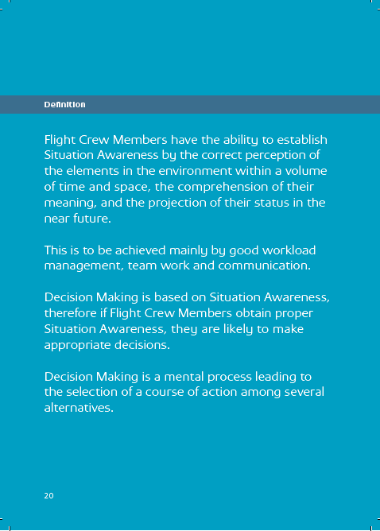
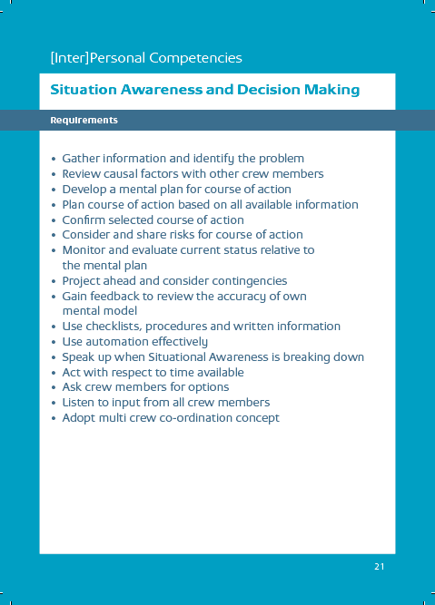
Communication & team behaviour
73

Slide 74
Resilience
Definition:
Ability of a system to adjust its functioning prior to, during, or following changes and disturbances, so that it can sustain required operations under both expected and unexpected conditions.
How do we do that?

Slide 75
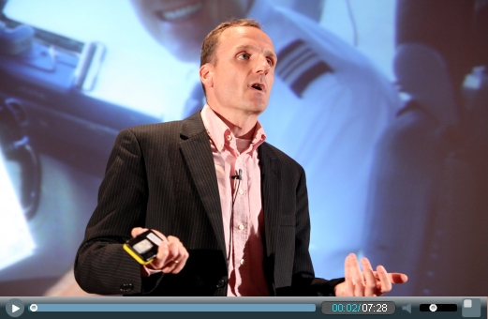
Resilience
„If things go right under difficult circumstances, it‘s mostly because of peoples adaptive capacity; their ability to recognize, adapt to and absorb changes and disruptions.“

Slide 76
Resilience Engineering
Noticing
Triggers
Action
Notice

Slide 77
Resilience Engineering
Communicate

Slide 78
Resilience Engineering
Anticipate

Slide 79
Resilience Engineering
Create Buffers

Slide 80
Resilience Engineering
Look for Critical Indicators

Slide 81

Resilience Engineering

Slide 82

Resilience Engineering
Recognize risk profile change
C A B L₃

Slide 83
Resilience Engineering
Recognize risk profile change
- Communicate
- Anticipate
C
A
B
L₃
- Create Buffers
Look for critical
indicators

Slide 84

Group Work

Slide 85
Group Work
Please think of a situation of your daily work where you faced a disturbance and where you succeeded in producing a positive outcome, that means a situation which went right.
What was the situation about?
When did you notice a risk profile change?
Which actions (CABL₃) helped to manage the situation?

Slide 86

Resilience Engineering and Human Error
The New View on human error:
The point is not to see where people went wrong, but why what they did made sense to them.
The aim is to help our organisation to learn something valuable from failure, instead of just saying “human error“.
Learning

Slide 87

Resilience and Learning

Slide 88
Resilience and Learning
Definition:
Ability of a system to adjust its functioning prior to, during, or following changes and disturbances, so that it can sustain required operations under both expected and unexpected conditions.

Slide 89
Resilience and Learning
Definition:
Ability of a system to adjust its functioning prior to, during, or following changes and disturbances, so that it can sustain required operations under both expected and unexpected conditions.

Slide 90
Resilience and Learning
Definition:
prior to
Ability of a system to adjust its functioning prior to, during, or following changes and disturbances, so that it can sustain required operations under both expected and unexpected conditions.
during
following
Recognize a situation before it appears
Learn to …
Be prepared and deal with it
Integrate successful strategies.

Slide 91

We have to learn to increase the things that go right
Resilience Engineering

Slide 92

Comments, remarks or questions?

